Slide 1
r4ss software for model diagnostics and plotting of SS output
Originally by Ian Taylor;
Additions by Teresa A’mar

Slide 2
Problem:
It takes hundreds of model runs to do a decent stock assessment
SS produces a large number of files and outputs that need to be checked
Even a few processing steps add up quickly
Solution:
Automate:
Input data error checks
Model convergence information
Output plotting
Diagnostics and residuals

Slide 3
Topics:
Introduction to r4ss
Functions and options
Demonstration

Slide 4
Prerequisites
R version 3.2.0 or later: https://www.r-project.org/ ;
https://cran.cnr.berkeley.edu/
Rstudio (optional):
https://www.rstudio.com/products/RStudio/#Desktop
Notepad++ (optional): https://notepad-plus-plus.org/ ;
http://portableapps.com/apps/development/notepadpp_portable
Tinn-R (optional):
http://sourceforge.net/projects/tinn-r/

Slide 5
Download options for r4ss
From CRAN : this lags behind the most recent version
> install.packages(“r4ss")
> library(r4ss)
Directly from GitHub: the most recent, but may have issues
> install.packages("devtools")
> devtools::install_github("r4ss/r4ss")
> library(r4ss)
Alternative GitHub: for uncooperative R installations
> install.packages(“devtools”)
> build_github_r4ss()
> library(r4ss)

Slide 6
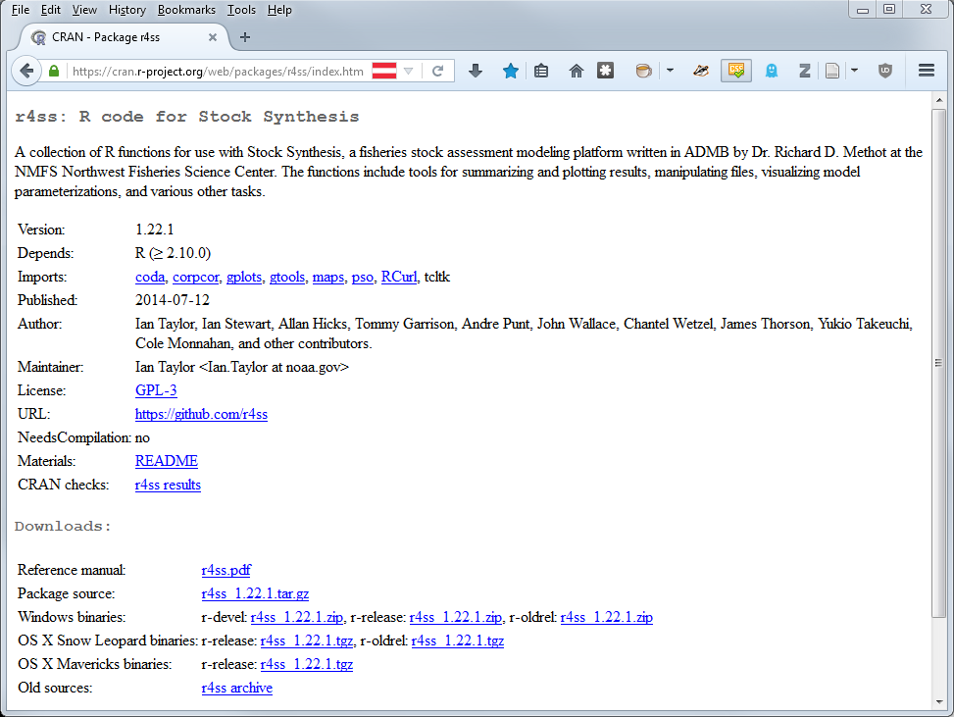

Slide 7
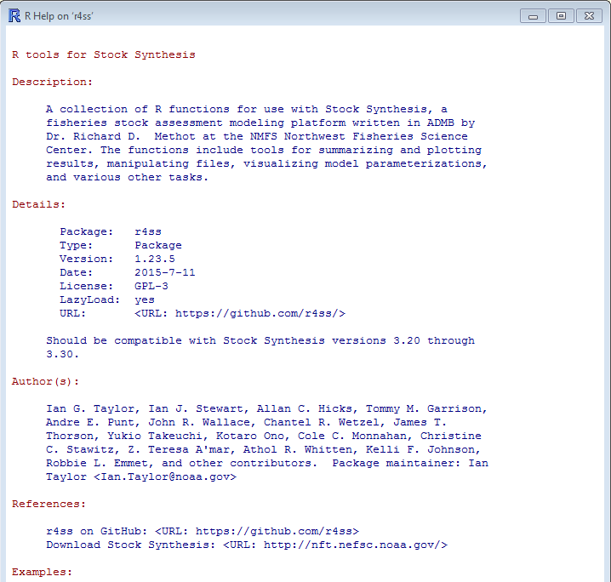
> ?r4ss

Slide 8
My general approach:
I usually alternate between:
Command line (for running models)
R (for diagnostics and visualizing model output)
A text editor (to track models and analyses)
This package is intended for “on-the-fly” modeling

Slide 9
Two primary functions:
SS_output()
- Grab all the output
- Summarize key quantities, statistics, diagnostics
- Create a list of objects for further processing
SS_plots()
- Make figures for model diagnosis
- Make figures for document preparation

Slide 10
Example
> library(r4ss)
> working.dir <- “C:\\Users\\Some.User\\SS model runs\\”
> setwd(working.dir)
> getwd()
> mymodelrun <- “base run directory”
> mymodel <- SS_output(dir=paste(working.dir, mymodelrun, sep=“”))
What is now in the console?
> names(mymodel)
> mymodel$derived_quants
…
{
}
optional

Slide 11
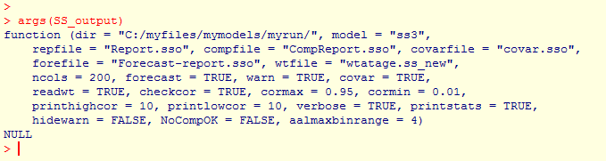
What are the inputs?
> args(SS_output)

Slide 12
Useful SS_output() arguments:
dir = “c:\\xxx\\yyy\\zzz\\...”
Locates the directory of the files to be read in
model = “ss3”
Name of the executable, you can rename
to indicate safe/optimized, or whatever you want.
ncols = 200
The maximum number of columns in files being read in.
If this value is too big, the function runs more slowly,
too small and you will get a warning. Find the right value for your model.
covar = TRUE
Check the Hessian quantities and produce uncertainty plots
forecast = TRUE
Read report and plot the forecast years
cormax = 0.95
The specified threshold for defining bad correlations

Slide 13
Example – more options
> mymodelrun <- “base run directory“
> mymodel <- SS_output(ncols=77, cormax=0.9, model="SS3",
dir=paste(working.dir, mymodelrun, sep=""))
…

Slide 14
Example
> SS_plots(mymodel)
> SS_plots(mymodel, plot=c(1:10,12:24))
- Where are these files?
- Can reopen later
> SS_plots(mymodel, png=FALSE, plot=c(1:10,12:24))
- Page up and down between plots
- Resizing
If you are using the R GUI plots (png=FALSE), add this before each new plotting call:
> rm(.SavedPlots,pos=1)

Slide 15
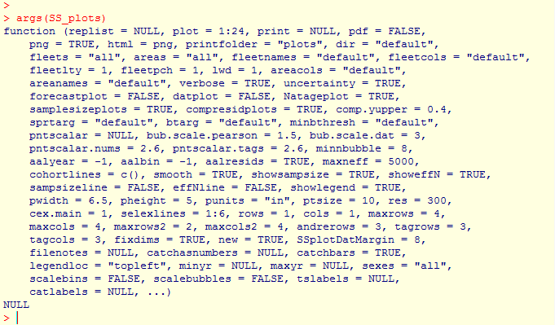
What are the other inputs?
> args(SS_plots)

Slide 16
Just a few of the plotting arguments:
plot = c(1:24)
Which plots to produce?
datplot = TRUE
Plot the data by itself? Useful in document preparation
and to make sure you got the inputs right
bub.scale.dat = 3
How big should you make the data bubbles?
tslabels, catlabels
Add your own custom axis labels

Slide 17
Example
> SS_plots(mymodel, datplot=TRUE, plot=c(1:10,12:24))
> SS_plots(mymodel, bub.scale.dat=7, datplot=TRUE, plot=c(1:10,12:24))
> SS_plots(mymodel, plot=c(1:10,12:24), png=FALSE)
> rm(.SavedPlots,pos=1)
> SS_plots(mymodel, comp.yupper = 0.6, plot=c(1:10,12:24), png=FALSE)
> abline(h=200000,col="red",lwd=2)
# Grab a slightly older version:
> devtools::install_github("r4ss/r4ss", ref="v1.23.1")

Slide 18
Other functions:
Compare two models
> mymodelrun2 <- “alternative model directory“
> mymodel2 <- SS_output(ncols=77, cormax=0.9, model="SS3",
dir=paste(working.dir, mymodelrun2, sep=""))
> mycomparisonlist <- list(mymodel, mymodel2)
> mycomparisonsummary <- SSsummarize(biglist=mycomparisonlist)
> rm(.SavedPlots,pos=1)
> SSplotComparisons(summaryoutput=mycomparisonsummary)

Slide 19
Other functions:
Compare two models
> SSplotComparisons(summaryoutput=mycomparisonsummary,
spacepoints=1, staggerpoints=0, legend=FALSE)
> SSplotComparisons(summaryoutput=mycomparisonsummary,
legendlabels=c(“Base model”, “Alternative model”),
indexfleets=rep(15,2), indexUncertainty=TRUE,
legendloc=“topleft”, xlim=c(1980,2016))
-- Don’t forget ---
> rm(.SavedPlots,pos=1)
> SStableComparisons(summaryoutput=mycomparisonsummary)

Slide 20
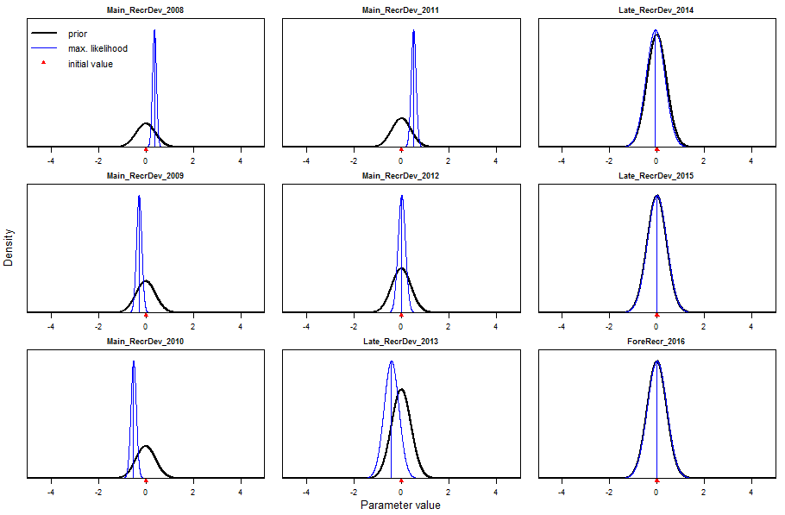
Plot the parameter estimates and uncertainty
> SSplotPars(dir=paste(working.dir, mymodelrun, sep=""))

Slide 21
A few notes:
Read the GUI output! It has important stuff in it.
HTML doesn’t always update when directories are copied
-- delete old plots for each new model directory
Plots can (and often should be) resized manually at the GUI
Headers are designed to remind the user, and should be cropped off later
- Demo font size, save, load, crop

Slide 22
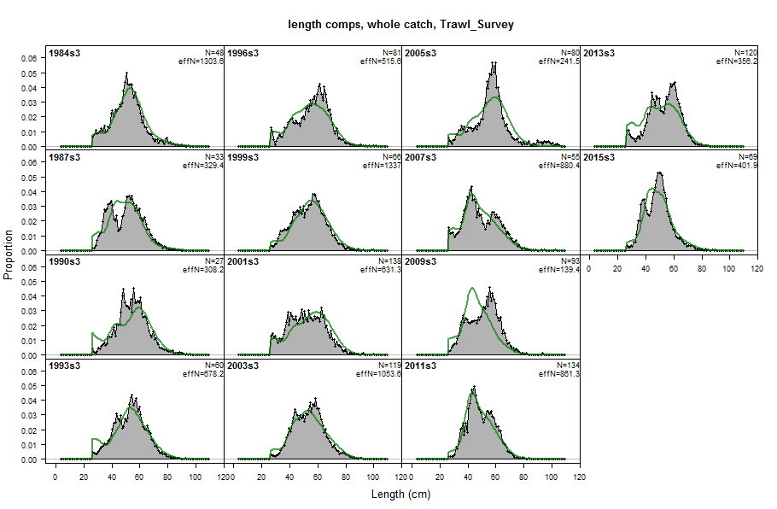
Headers:

Slide 23
Things r4ss doesn’t do:
At least one important aspect of any specific assessment
But you can:
Add to existing plots
Find and use objects directly
Pass specific arguments to subfunctions: e.g. custom labels
Modify the code for your needs
Make you a cup of coffee while your model converges and the Hessian inverts

Slide 24
r4ss is open source:
https://github.com/r4ss/r4ss
Download the code, post questions, report bugs, contribute!

